Slide 1
Predicting Recidivism in Released Prisoners in the State of Iowa
James M. Irving, Ph.D.

Slide 2
Can Iowa State use data on released prisoners to predict which prisoners will return to a life of crime?
FUNDAMENTAL QUESTION

Slide 3
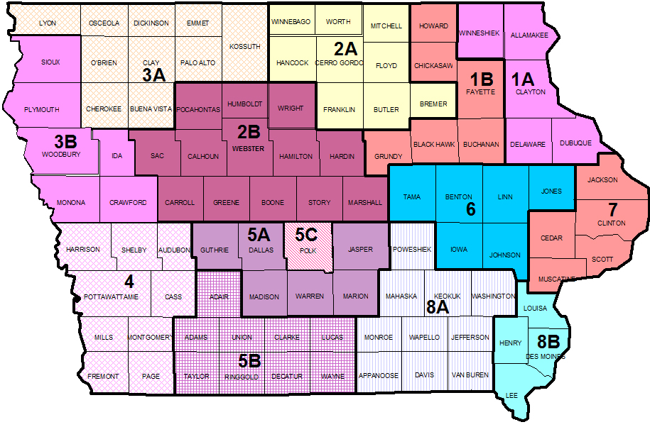
Data Source: Iowa Dept. of Corrections
Features Analyzed:
Fiscal Year Released
Recidivism Reporting Year
Race - Ethnicity
Convicting Offense Classification
Convicting Offense Type
Convicting Offense Subtype
Release Type
Main Supervising District
Recidivism - Return to Prison
Part of Target Population

Slide 4
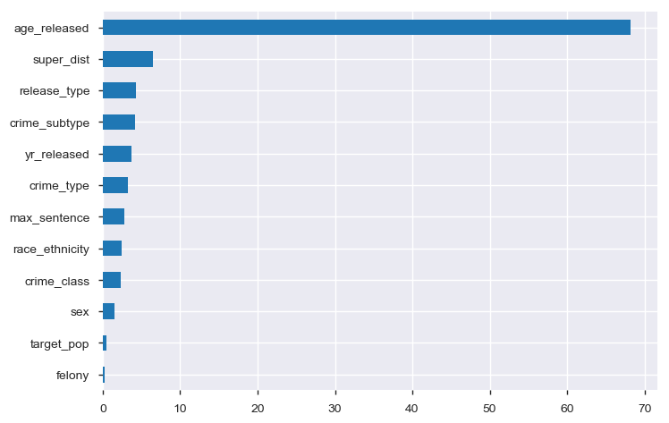
Important Features in Predicting Recidivism
Age-At-Release
Supervising Judicial District
Type of Release
Crime Subtypes
Feature Name
Feature Importance

Slide 5
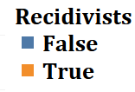
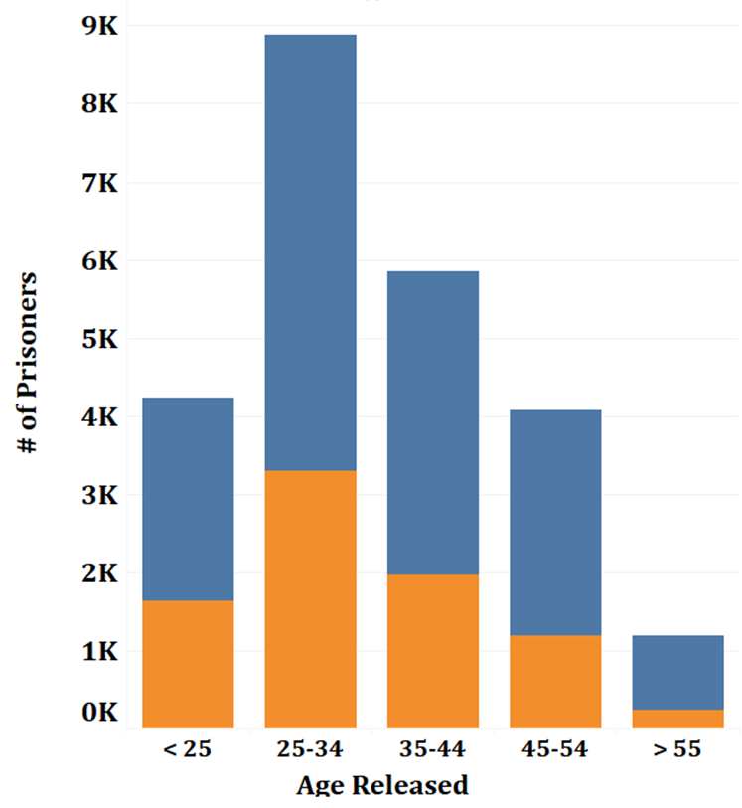
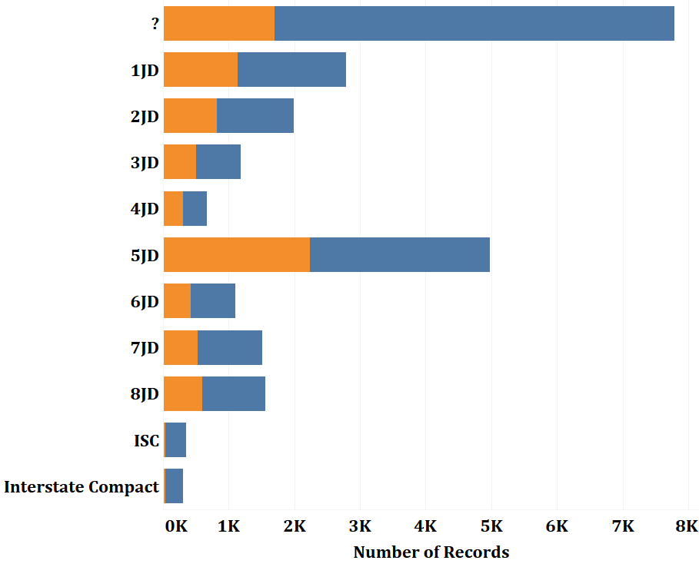
#1) Age at Release #2) Judicial District

Slide 6
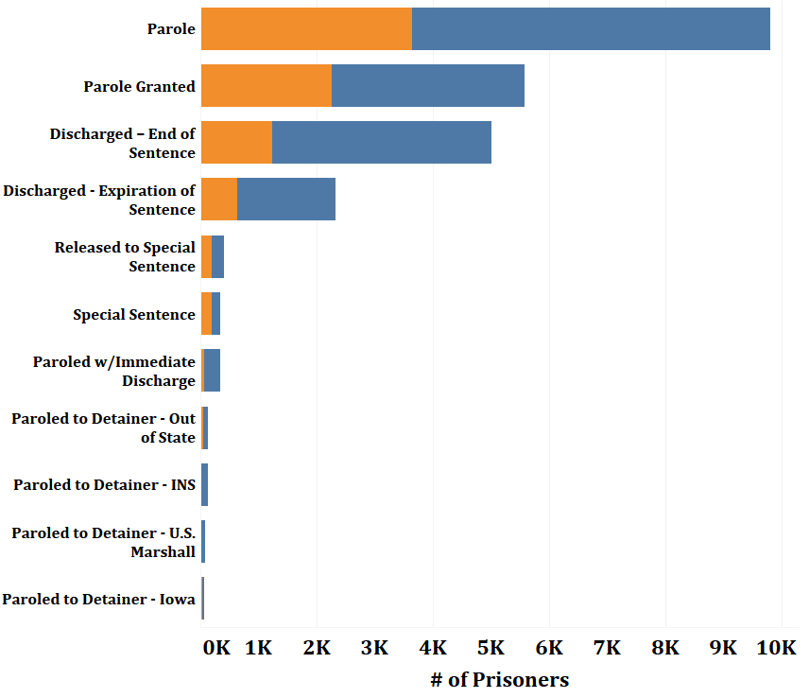
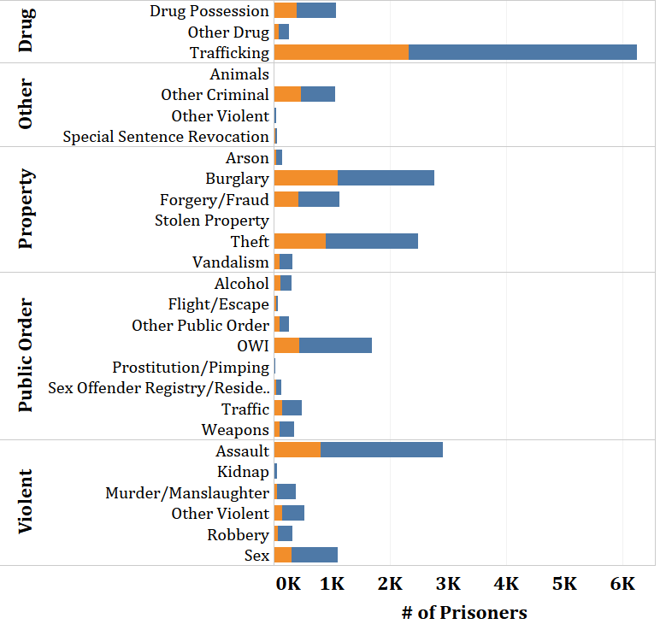
#3) Release Type #4) Crime Type-Subtypes

Slide 7
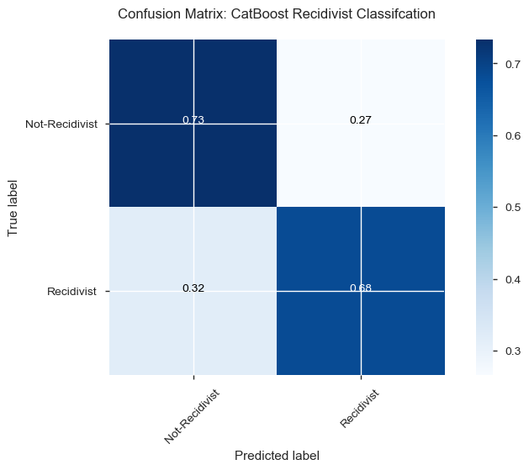
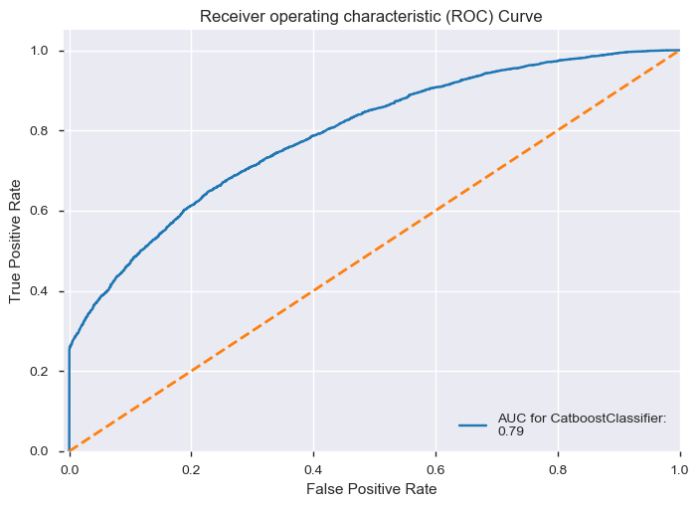
Classification Model Performance

Slide 8

Conclusions & Recommendations
Using our model, Iowa Department of corrections can predict which prisoners may become recidivist.
Using this information, Iowa can implement pre-release educational programs to target at-risk prisoners.
Following release, Iowa could also provide post-release support and intervention to at-risk prisoners.

Slide 9

THANK YOU
Michael Moravetz – Collaborator
Flatiron School – Data Science Bootcamp
Brandon Lewis – Instructor
Jeff Herman – Advisor
Python Packages:
Cookie-Cutter Python Package
for Enabling BroadSteel_DataScience
https://cookiecutter-pypackage.readthedocs.io/en/latest/
CatBoost Machine Learning Package
Superior Modeling with categorical data.

